Slide 1
CANCER DETECTION USING HYBRID ML TECHNIQUES

Slide 2
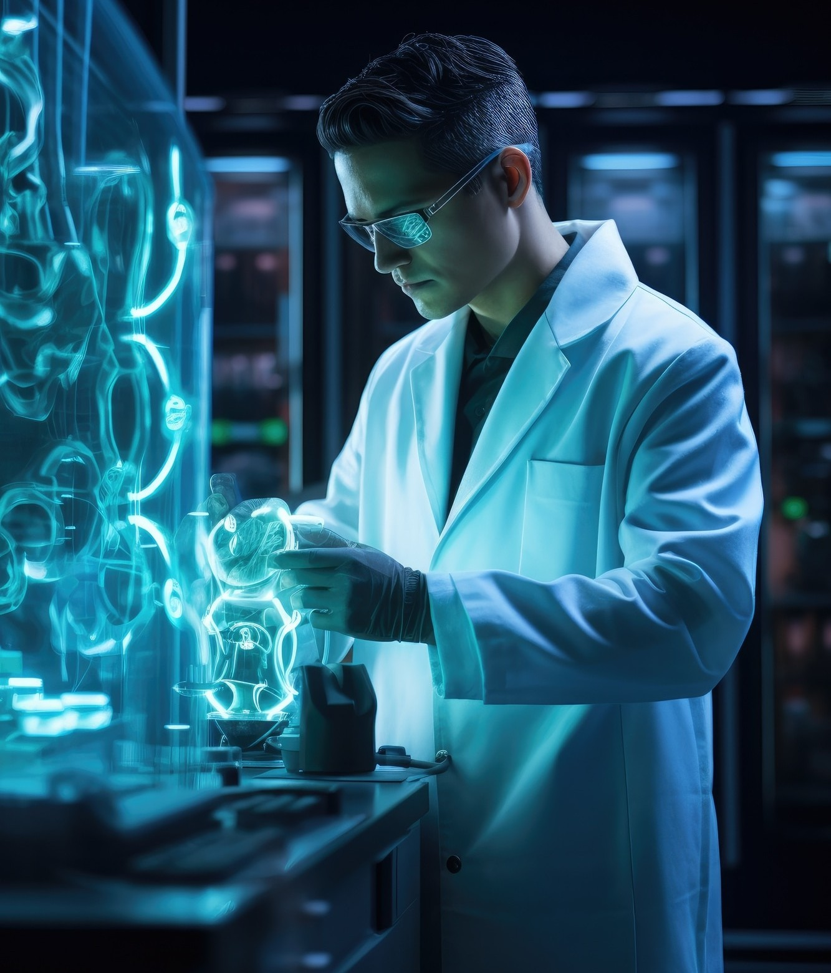
INTRODUCTION
In this presentation, we will explore how hybrid machine learning techniques are revolutionizing cancer detection. We will delve into the latest advancements and their potential impact on early diagnosis and treatment. Join us on this insightful journey.

Slide 3
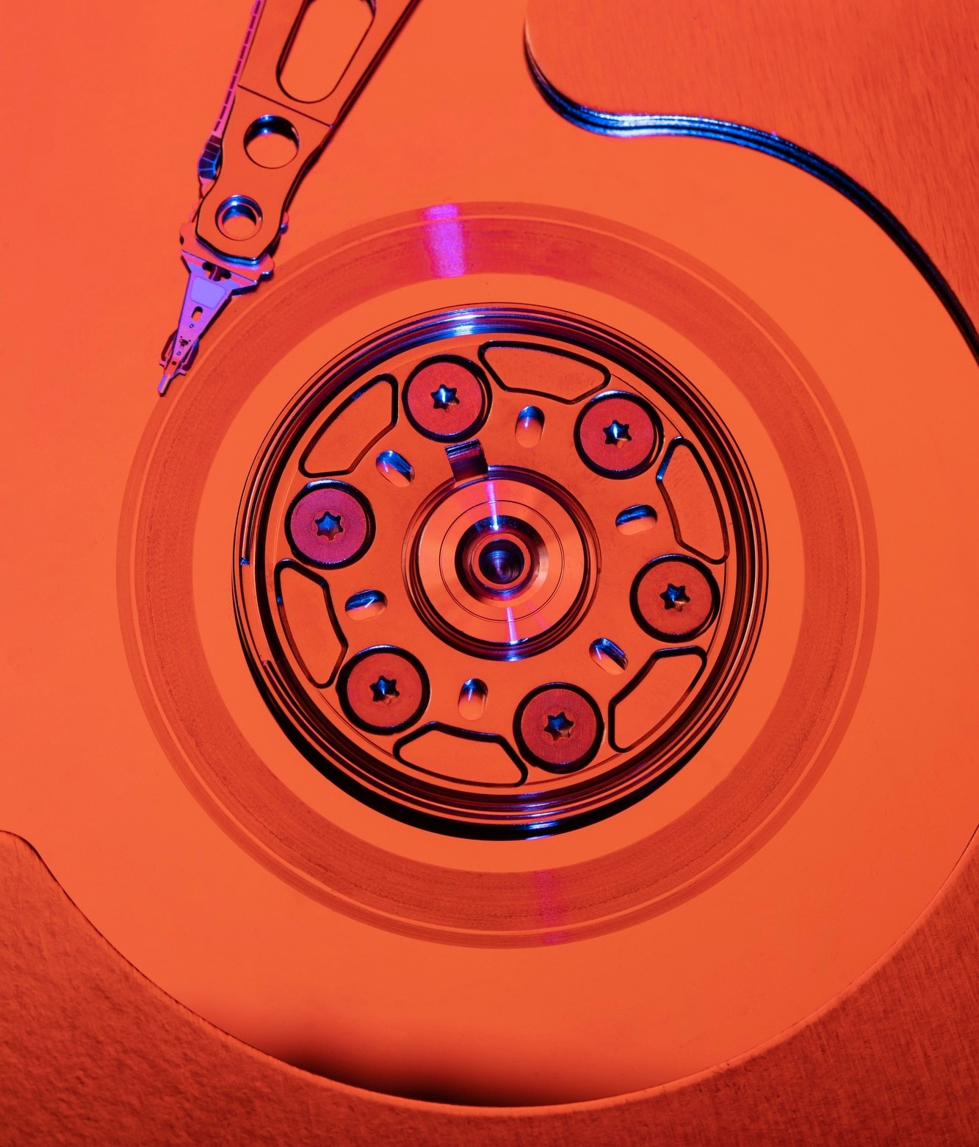
UNDERSTANDING CANCER DETECTION
Before delving into the advancements, it's crucial to understand the complexities of cancer detection. From genetic markers to imaging techniques, a multi-faceted approach is essential in the ﬁght against this disease.

Slide 4
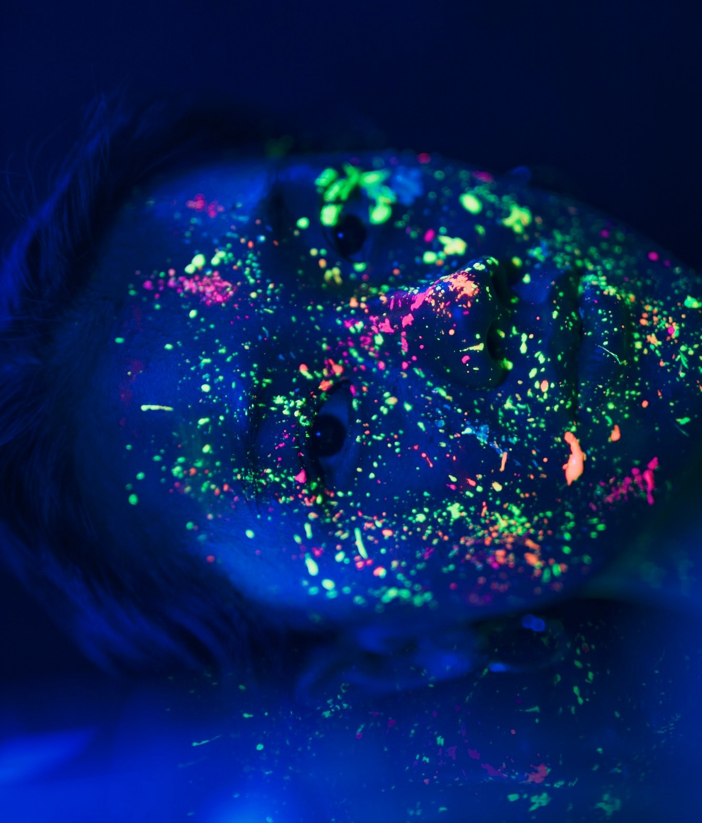
THE ROLE OF HYBRID MACHINE LEARNING
Harnessing the power of hybrid machine learning involves integrating multiple algorithms and data sources to enhance accuracy and efﬁciency. This approach enables the identiﬁcation of subtle patterns and anomalies that may be indicative of cancer.

Slide 5
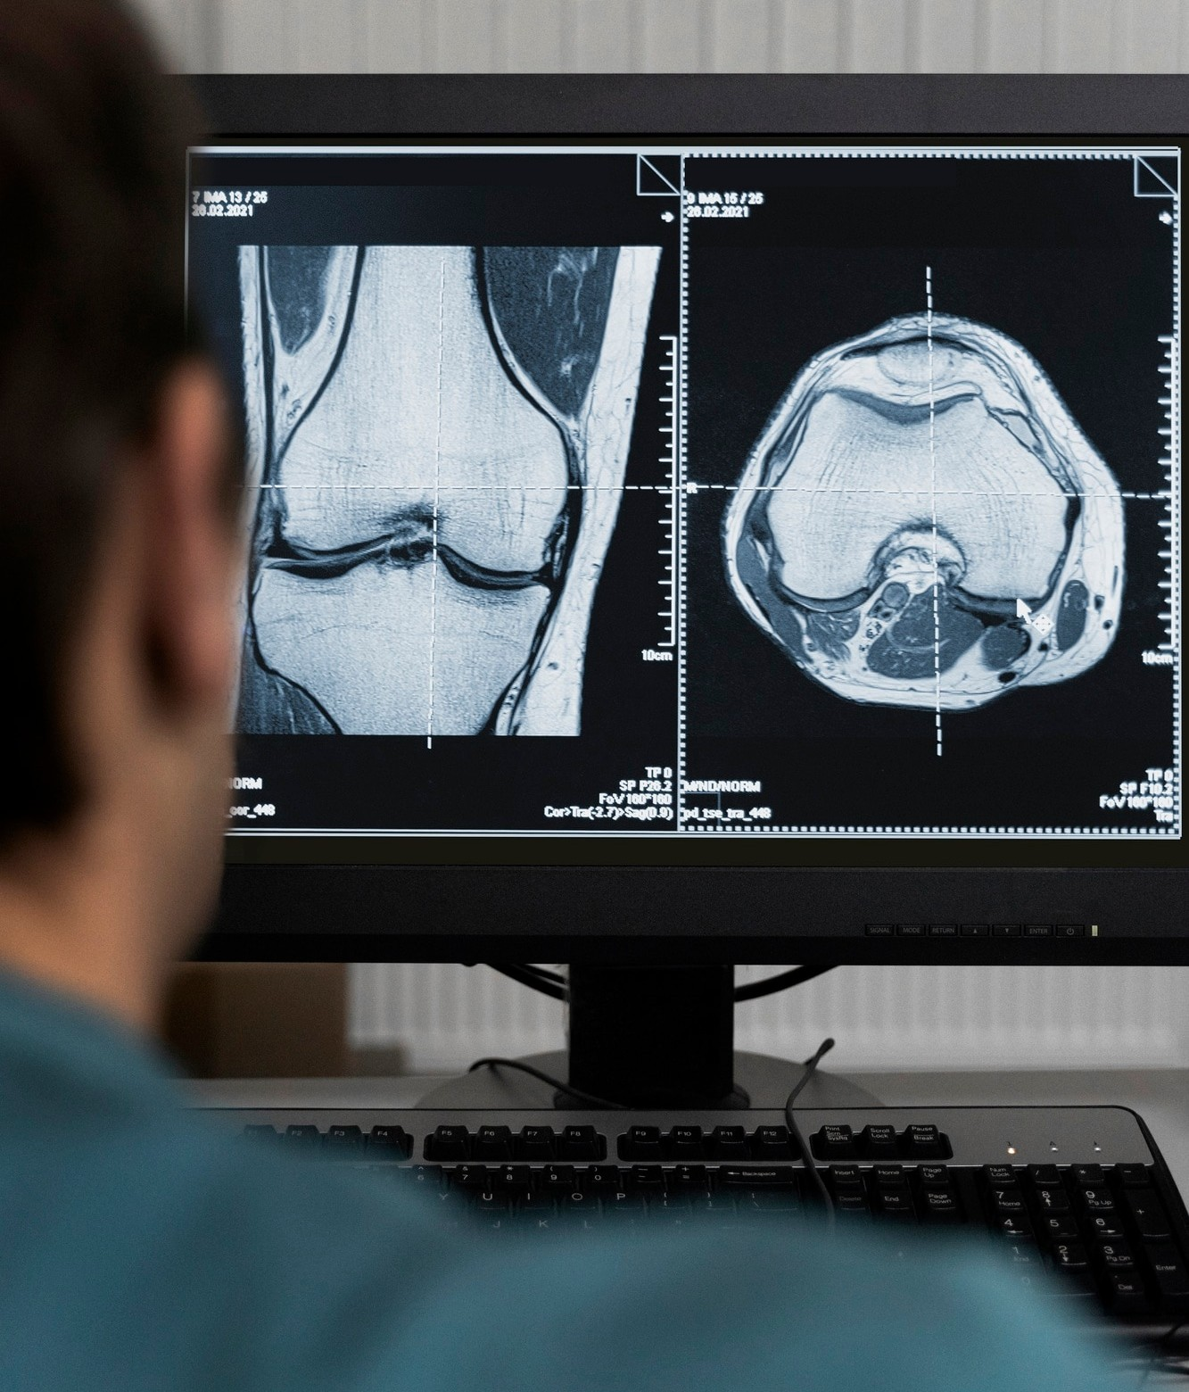
ADVANCEMENTS IN IMAGING TECHNOLOGY
Cutting-edge imaging technology has signiﬁcantly improved the visualization of tumors and abnormalities.
From MRI to CT scans, these advancements have revolutionized the early detection of cancer, leading to more effective treatment.

Slide 6
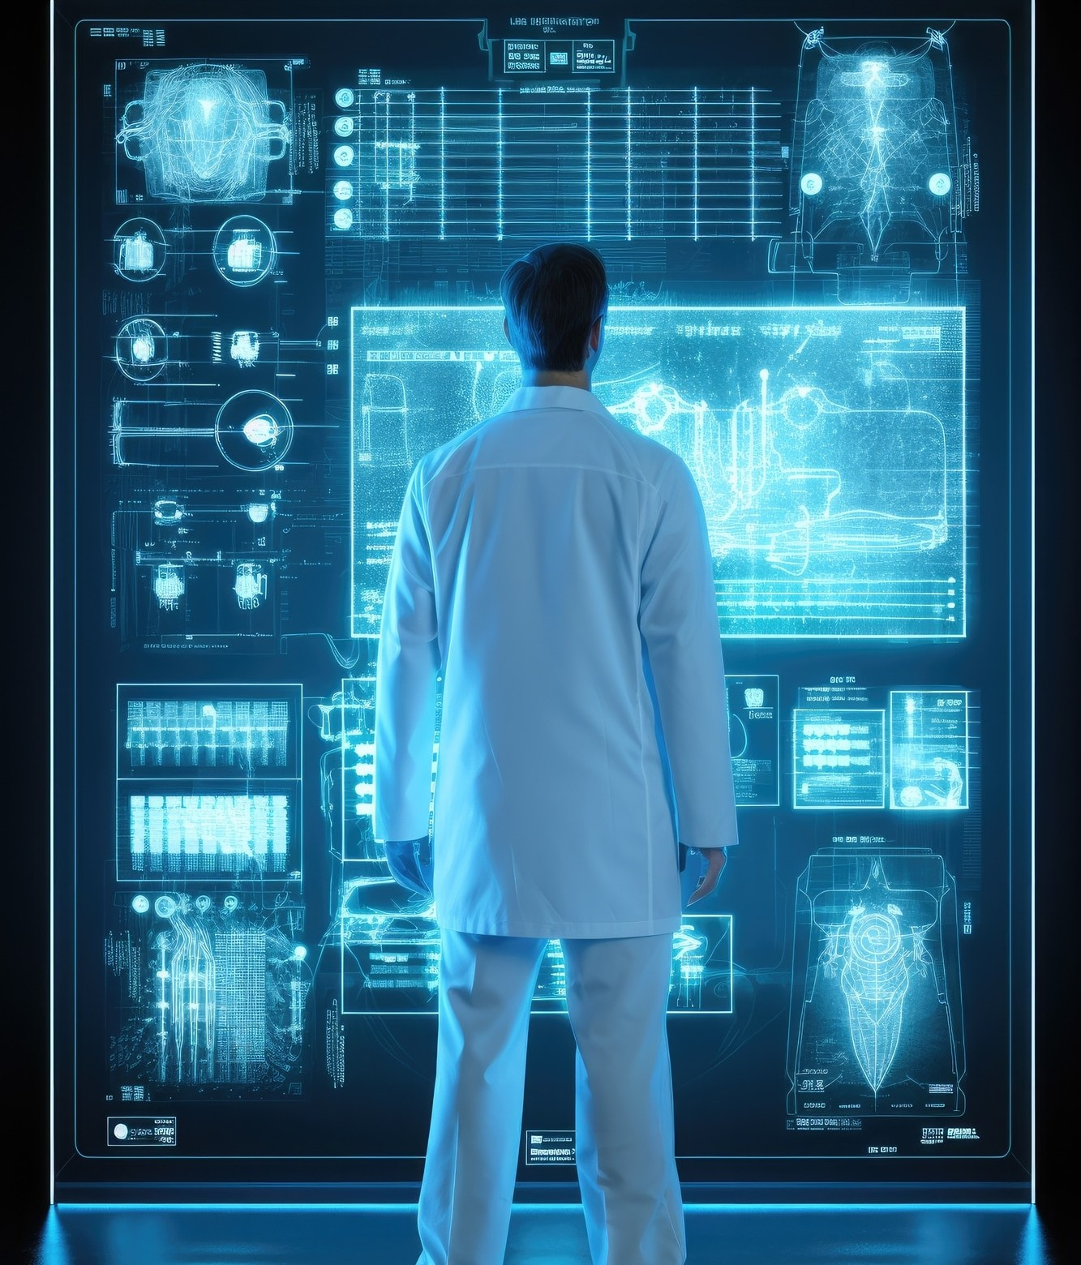
CHALLENGES AND OPPORTUNITIES
While the potential of hybrid machine learning in cancer detection is immense, challenges such as data integration and model interpretability need to be addressed. Embracing these challenges presents opportunities for further innovation and progress in the ﬁeld.

Slide 7
CONCLUSION
The fusion of hybrid machine learning techniques with advanced imaging technology holds great promise in the early detection and treatment of cancer. As we continue to push the boundaries of innovation, the impact on patient outcomes and survival rates is poised to be profound.

Slide 8

Thanks!

